Slide 1

Javascript (MongoDB)
by
M NAVEENKUMAR
Assistant Professor
Department of Computer Science and Engineering
SRI RAMACHANDRA ENGINEERING AND TECHNOLOGY
Sri Ramachandra Institute of Higher Education and Research

Slide 2
MongoDB

Slide 3
MongoDB
Is used in many apps such as Dektop, web app etc.
Two popular stacks (full JS applications)
MongoDB is also JS based database. (Mozilla’s spider monkey JS Engine)
It is a Document DB (No SQL DB)
MERN
MongoDB
Express
React
NodeJS
MEAN
MongoDB
Express
Angular
NodeJS

Slide 4
Relational (SQL) vs Document (NoSQL)
Relational | Document
Data is stored in Tables | Data is stored in Documents
Fixed Schema | No Schema
Tables are having relations one –one one-many | Documents are independent
Joins are needed to extract data from more than one table | No joins

Slide 5
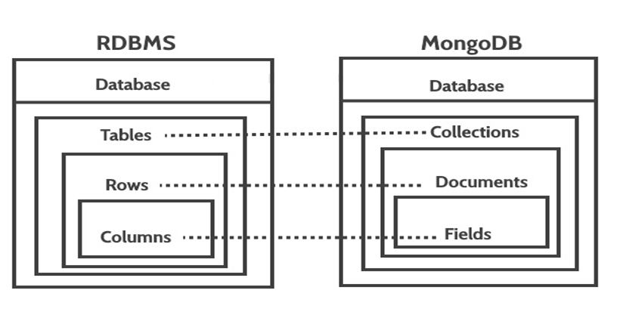
Relational (SQL) vs Document (NoSQL)

Slide 6
MongoDB structure
Database = set of collections
Collection = set of documents
Database
collections
Collections
Products
Product categories
customers

Slide 7
MongoDB structure
Mongo Shell
mongo
Mongo Server
mongod

Slide 8
JSON, BSON, Extended JSON
JSON : javascript object notation, popular standard for data interchange on the web.
BSON : binary JSON
 | JSON | BSON
Encoding | UTF-8 String | Binary
Data Support | String, Boolean, Number, Array | String, Boolean, Number (Integer, Float, Long, Decimal128...), Array, Date, Raw Binary
Readability | Human and Machine | Machine Only

Slide 9
JSON Example
{
"id": 1,
"name" : { "first" : "John", "last" : "Backus" },
"contribs" : [ "Fortran", "ALGOL"]
}

Slide 10
JSON vs JS object
{
"id": 1,
"name" : " john" ,
"contribs" : "Fortran"
}
{
id: 1,
name : " john" ,
contribs : "Fortran"
}
JSON
JSON.parse()
JS Object
JSON.stringify()

Slide 11
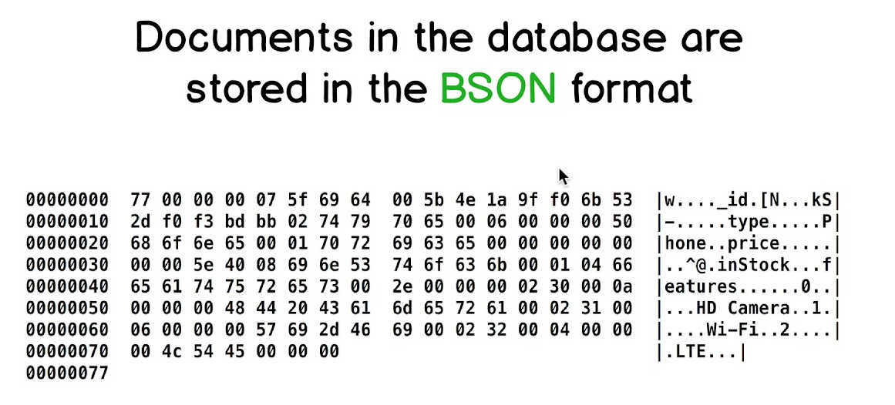

Slide 12
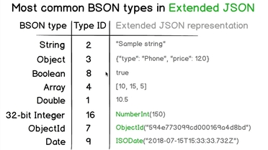

Slide 13
Create new collection
use myDB // to navigate DB
db.createCollection(“customer”) //creating new collection
Show collections // visualise collections
db.

